Slide 1

Copilot Studio – Let’s Build

Slide 2













Slide 3




About
Managing Consultant at Capgemini Norge
Copilot SME (Subject Matter Expert)
More than 25 years a consulant in various companies
Microsoft MVP
Podcast host for @TeamsCastAway https://teamscastaway.no
Telco Expert
Microsoft MVP
Linkedin: https://www.linkedin.com/in/kaistenberg/

Slide 4

Agenda
What is Copilot Studio
1
Let’s login and create a bot
2
Entra ID and bot security
3
Add knowledge to the bot
4
Publish the bot
5
Q/A
6

Slide 5
All presentations should have quote!
"Why did the banana bring a suitcase to the moon? Because it wanted to see the cheese crater dance with the jellyfish!“
Quote By Copilot ☺

Slide 6
What is Copilot Studio?
Copilot Studio was earlier named Power Virtual Agents (PVA)
Copilot Studio is the place to create bot
Can be used to create Chat bots
Can be used to create voice bots for integrations with Microsoft Digital Contact Center (Dyn365 customer Service)
Use AI

Slide 7
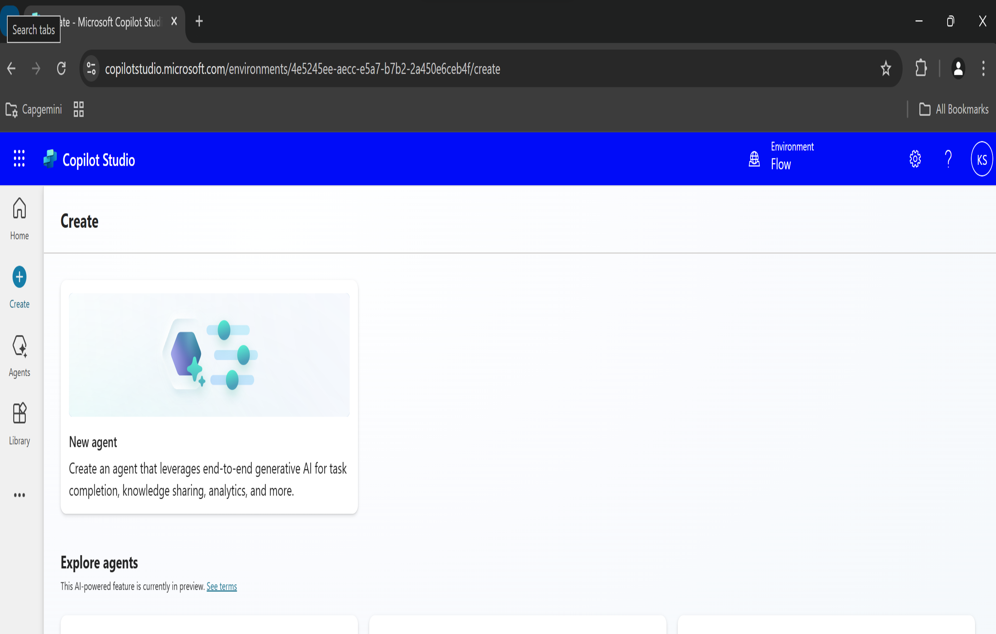
Lets login to Copilot Studio
https://Copilotstudio.microsoft.com
DEMO

Slide 8

Entra ID and Security for the bot

Slide 9
Add Security to the bot

Slide 10
Add knowledge to the bot

Slide 11
Publish the bot to a website or Sharepoint Site

Slide 12

Q/A

Slide 13
About Capgemini
Capgemini is a global business and technology transformation partner, helping organizations to accelerate their dual transition to a digital and sustainable world, while creating tangible impact for enterprises and society. It is a responsible and diverse group of 340,000 team members in more than 50 countries. With its strong over 55-year heritage, Capgemini is trusted by its clients to unlock the value of technology to address the entire breadth of their business needs. It delivers end-to-end services and solutions leveraging strengths from strategy and design to engineering, all fueled by its market leading capabilities in AI, cloud and data, combined with its deep industry expertise and partner ecosystem. The Group reported 2023 global revenues of €22.5 billion.
Get the future you want | www.capgemini.com

